Slide 1
Questions for meeting:
What do you expect to get out of the cooperation / this project?
What is the meaning behind the features? Please try to explain this for people who have no idea about optics or physics in general
How are they related to each other? Some relations are clear from the paper, but for example q_{ext/abs/sca} seem to be closely correlated as well.
What degree of accuracy do you need for your application? What would be an acceptable error?
What are typical ranges of the features (both input and output)?
Can you give us the paper “Applying machine learning to estimate the optical properties of black carbon fractal aggregates” mentioned in your presentation? Or at least a summary? We can’t access it (at least not for free) since the university doesn’t have a contract with Elsevier.

Slide 2
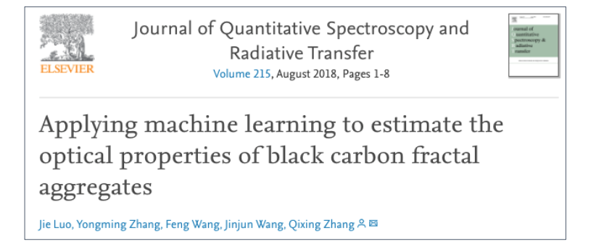
Using machine learning to expand the database for black carbon aerosol
Background
Drawback:
They did not consider differenct compositions (or coating %)
Only limited to forward problem
Our idea
Use a database of black carbon aersol we have from Romshoo et al., 2021 as a training dataset for expanding the current database

Slide 3
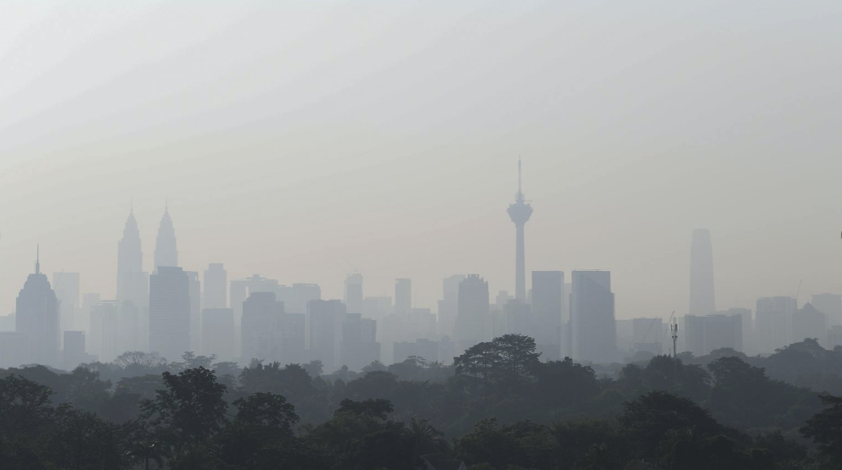
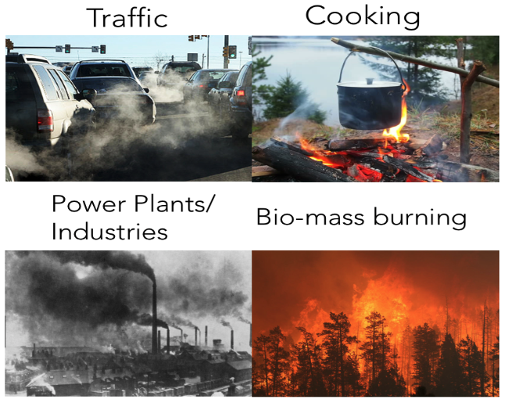
What is black carbon aerosol?
Black carbon aerosol (or soot) is a fine particulate matter present in the atmosphere
Sources of black carbon
Major impacts on climate, eco-system, and human health

Slide 4
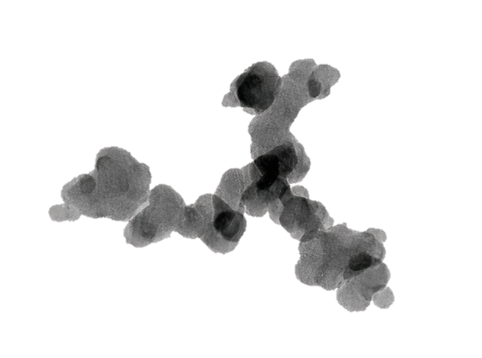
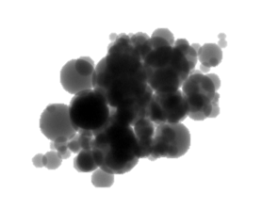
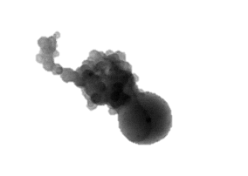
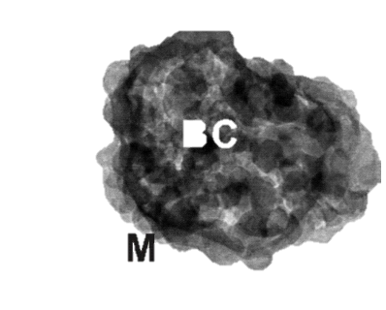
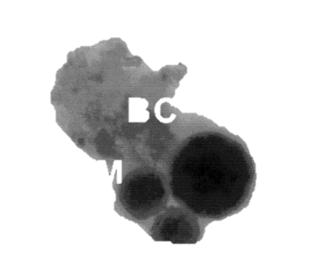
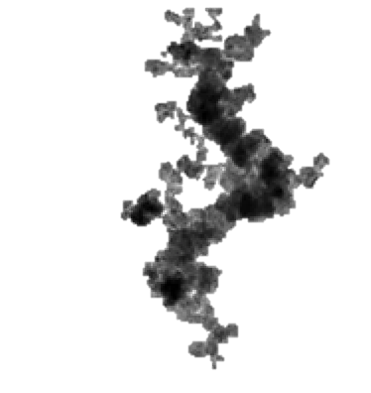
Features of the database
The database has been divided into three parts:
Physical parameters
Constants
Optical parameters
Physical parameters
Morphology
1. Fractal dimension: Defines the shape/morphology of the BC aggregate
Composition
2. Fraction of coating: Percentage of non-BC component (usually in the form of coating) in the particle
Size
3. Number of primary particles: The number of primary particles in a BC aggregate
Black carbon aerosol
4. Volume equivalent radius outer: The volume equivalent radius of a sphere having the same volume as that of the complete BC aggregate.
Found as a fractal aggregate
5. Volume equivalent radius inner: The volume equivalent radius of a sphere having the same volume as that of the BC aggregate without the non-BC component (coating).
6. Mobility diameter: Measured experimentally by the mobility size spectrometer
Mass and Volume
7, 8, 9. Total volume of the whole aggregate; volume of the BC component of aggregate; volume of the nonBC component of aggregate
10, 11, 12. Same as volume for mass
Others
14. Wavelength: The wavelength at which the optical parameters are calculated

Slide 5
Features of the database
The database has been divided into three parts:
Physical parameters
Constants
Optical parameters
Constants
Morphology
Size
1. Primary particle size: Size of the primary particle (red circle) of the BC aggregate
Density
2. Density of BC
3. Density of non-BC
Black carbon aerosol
Found as a fractal aggregate
Others
4, 5. Real part of the refractive index of BC; Imaginary part of the refractive index of BC
6, 7. Real part of the refractive index of nonBC; Imaginary part of the refractive index of nonBC
There is a scope of expanding the current dataset to include them as varying parameters

Slide 6
Features of the database
The database has been divided into three parts:
Physical parameters
Constants
Optical parameters
Optical cross-sections
Extinction cross-section: measure of the incident irradiance/light (scattered + absorbed by the particle)
Absorbtion cross-section: measure of the absorbed irradiance/light
Scattering cross-section: measure of the scattered irradiance/light
Extinction cross-section = Absorption cross-section + scattering cross-section
Optical Efficiency Factor
Normalisation of optical cross-section with the projected cross-section of a particle
Extinction efficiency
Absorbtion efficiency
Scattering efficiency
Extinction efficiency = Absorption efficiency + scattering efficiency
Others
7. Single scattering albedo: ratio of scattering efficiency to extinction efficiency
Assymetry parameter: gives information about the nature of scattering: forward or backward
Mass absorption cross-section: absorption cross-section per mass (total mass; BC mass; non-BC mass)

